Slide 1



Engaging Parents as Quality Improvement Partners: Introducing the Well Visit Planner
April 11, 2013
Christina Bethell, PhD, MBA, MPH
The WVP was developed and tested by the Child and Adolescent Health Measurement Initiative (CAHMI) for use in pediatric practices over four years and through a grant from the federal Maternal and Child Health Bureau (R40 MC08959). Its continued development and implementation is supported by the CAHMI, volunteer advisors and through support from HRSA/MCHB through Cooperative Agreement U59-MC06890.

Slide 2
Presentation Goals
Inspire your interest in methods to engage parents and families directly in measuring and improving health care quality and outcomes
Discover at least one way these methods may have relevance for your focus for promoting health and health outcomes in maternal and child health research, policy and practice
Learn from you to optimize the alignment of this work with opportunities to collaborate in improving MCH

Slide 3
Quick Snapshot of the CAHMI
The CAHMI provides leadership to define, assess and inspire patient-centered interventions to improve children’s health. We promote early and lifelong health of children using patient-centered data and tools.
Key Areas of Innovation:
Family-centered child & adolescent health measurement & improvement at the national, state & local levels (DRC; NQF)
Tools to inform and activate families as quality measurement and improvement partners
Stakeholder facilitation to inspire, inform and track transformation and best practices
Nation
Community
Health Plan
Practice
State
Patient

Slide 4
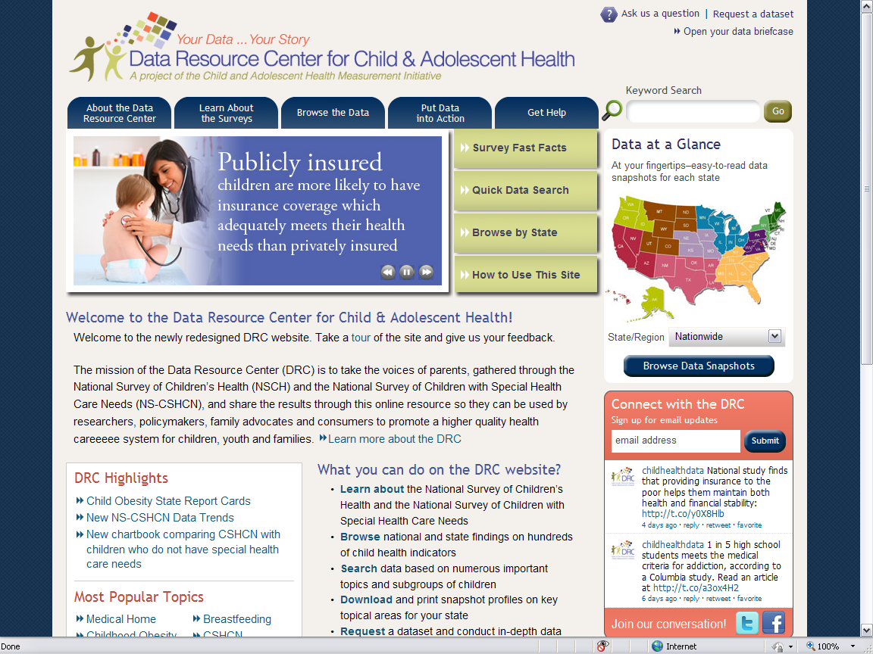

Slide 5

Flow
Rationale for and overview of patient centered quality measurement and improvement (PCQMI)
In depth review of the design, testing and application of the Well Visit Planner
Dialogue about opportunities and address questions

Slide 6
  Motivation: Patients are the most underused resource for quality improvement!

Slide 7
Motivation: What Does the Evidence Say?
Partner, Engage and Activate Patients!
The evidence suggests it will:
Improve safety by reducing errors
Improve compliance
Lead to fewer no-shows
Encourage better self-care behaviors
Reduce repeat procedures
Foster better care coordination
Build greater trust
Enhance communication

Slide 8
  Motivation: PCQMI Methods Research Base
Health psychology and information science suggest that:
  active two-way partnerships between patients and clinicians…
  coupled with an assessment-based approach to tailoring the content of care help…
  promote the likelihood of salient and effective delivery of communication-based health care
The WVP tools are based on the mutual-participation and the elaboration-likelihood health communication models.

Slide 9
  Motivation: How do we Engage Parents?
  PCQMI Methods - Effects on Quality
The primary mechanisms for improvement are:
  educating and priming (cueing) parents and their pediatric clinicians to focus on priority topics and priority parent needs;
  establishing a method for easy collection and transfer of information about these needs and priorities; and
  facilitation of a patient-centered context of care.

Slide 10
The Vision: Empowering A Cycle of Patient-Provider Engagement
(1) Promoting Healthy Development Survey; (2) WVP; (3) PHDS

Slide 11
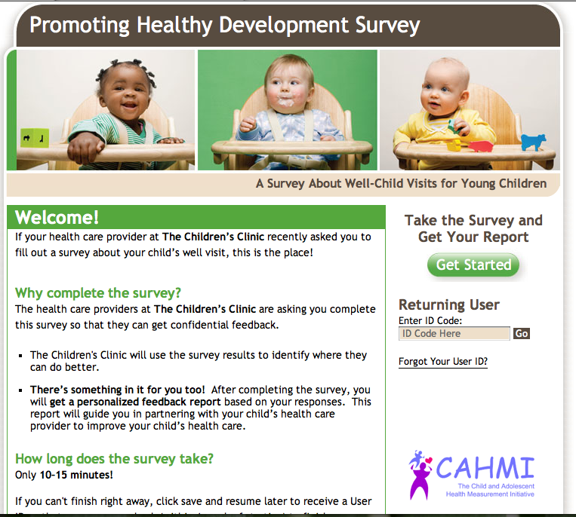
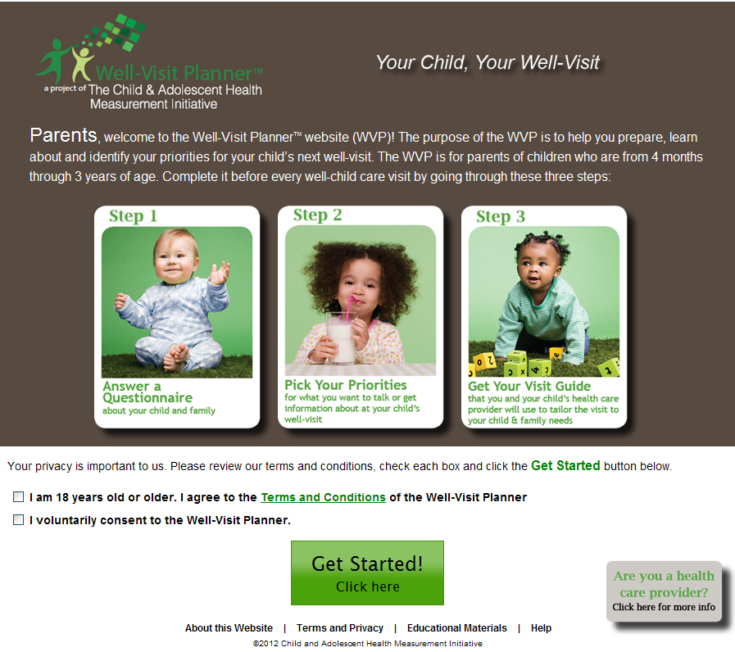
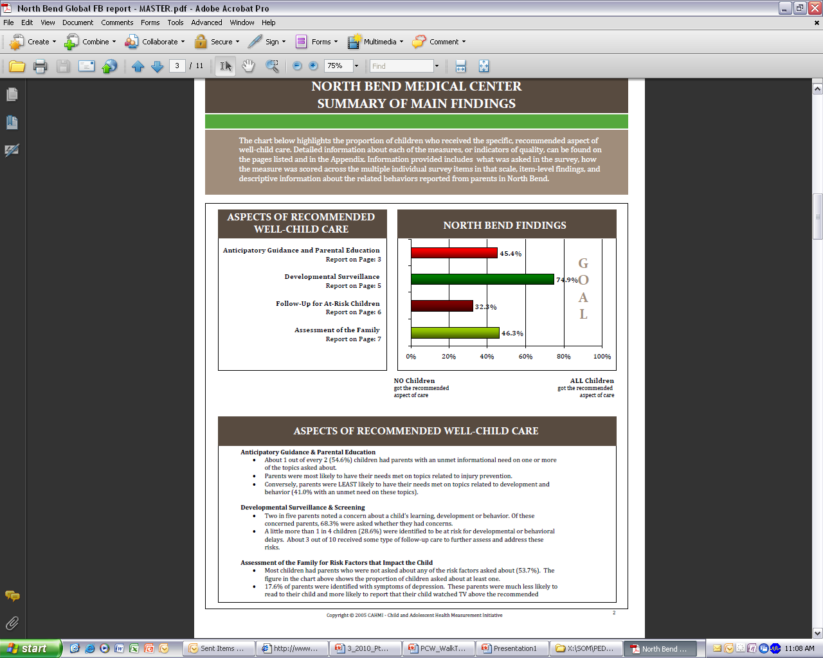
Core Well Visit Planner (WVP) tools?
  Quality Measurement: Promoting Healthy Development Survey
  Quality Improvement: Well Visit Planner Pre-Visit Planning

Slide 12
Phase I: Promoting Healthy Development Survey
THE PROMOTING HEALTHY DEVELOPMENT SURVEY
Parent-Centered: The PHDS is completed by parents of young children (ages 0-3)
Endorsed by the National Quality Forum (NQF)
Used for quality measurement at the national, state, plan, and provider-level. (10+ years)
Flexible longer and shorter versions available; online, mailed, telephone
Non-Proprietary
  KEY MEASURES:
  Anticipatory guidance and parental education
  Addressing parental concerns (Developmental surveillance)
  Standardized developmental and behavioral screening
  Follow-up care for children identified at-risk for developmental delays or behavioral issues
  Assessment of the family for risk factors to the child
  Family-centered care (Communication and experience of care)
More the 45,000 surveys have been collected by:
  10 Medicaid agencies, 26 health plans and hundreds of pediatricians
Nationally through the National Survey of Early Childhood Health (NSECH) and
National Survey of Children’s Health (NSCH).

Slide 13
PHDS: Measuring the Content of
Well Child Care Services
Anticipatory Guidance and Parent Education
Family Psychosocial
Assessment
Medical History
Developmental and Behavioral Assessment
Developmental
Services
Physical Exam
Referral & Care Coordination
Procedures
Sensory Screening
Immunizations
Measurements

Slide 14
Phase II: Pre-Visit Well Visit Planner (WVP)

Slide 15
The Well-Visit Planner Website: Three Steps
Parents of young children visit the Well-Visit PlannerTM website and complete the following steps before their child’s age-specific well visit:
Public use site available www. wellvisitplanner.org
Site specific/branded option with parent visit guide transfer into EMR: Coming Soon!
Full EMR integration: Beta testing in FQHC’s now.
Spanish language version nearing completion!

Slide 16
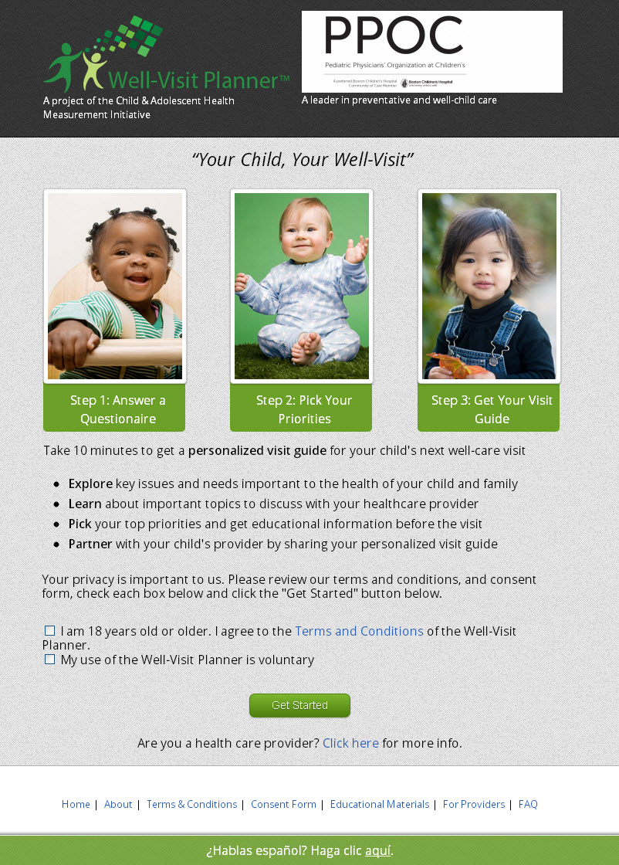
Example: Practice or Site Specific Version
Key Partners
  Harvard Pilgram’s Pediatric Physicians’ Organization (PPOC) at Boston Children’s
  Children’s Health Alliance (Oregon)
  FQHC’s (Los Angeles area)
Key Issues
  Data Transfer Protocol (e.g. secure faxing into EMR)
  Data Security & PHI Standards (cross institutional)
  Aggregated Data Reports & Population Based Data Set
Establishing the Real-World Process
  Dissemination and implementation
  Technical support infrastructure
  Continuous learning and updates

Slide 17
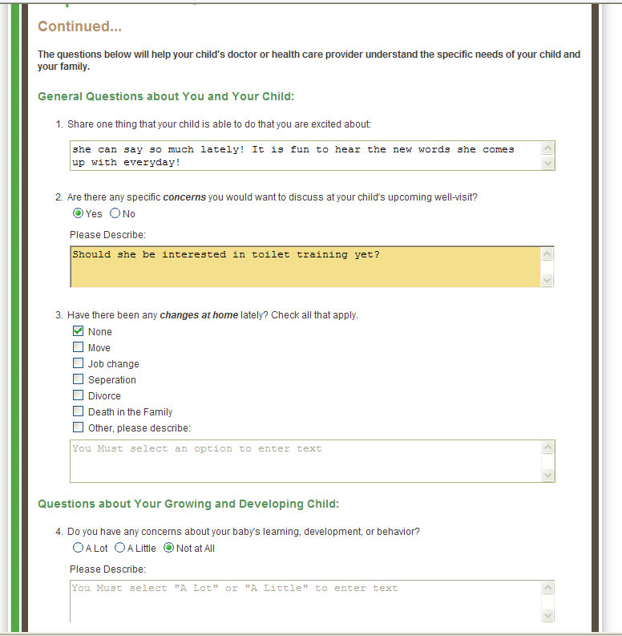
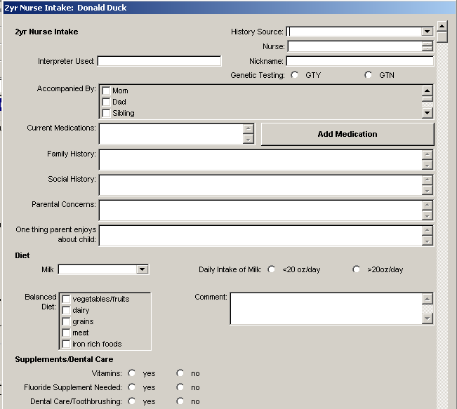
Full EHR Integration
[Parent report: Should she be interested in toilet training?]

Slide 18
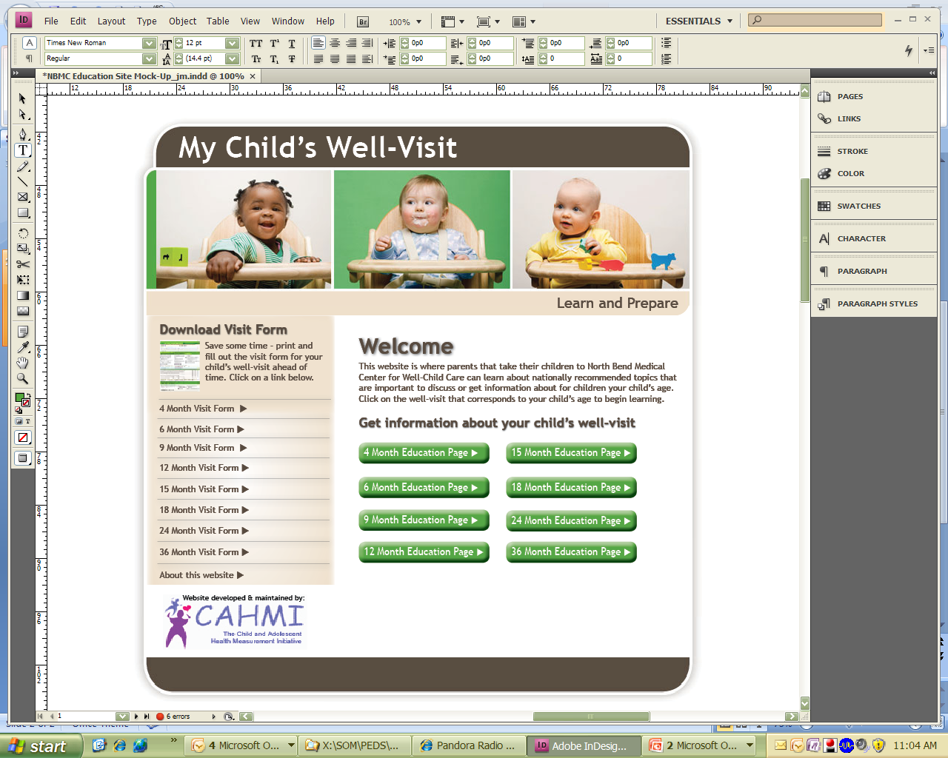
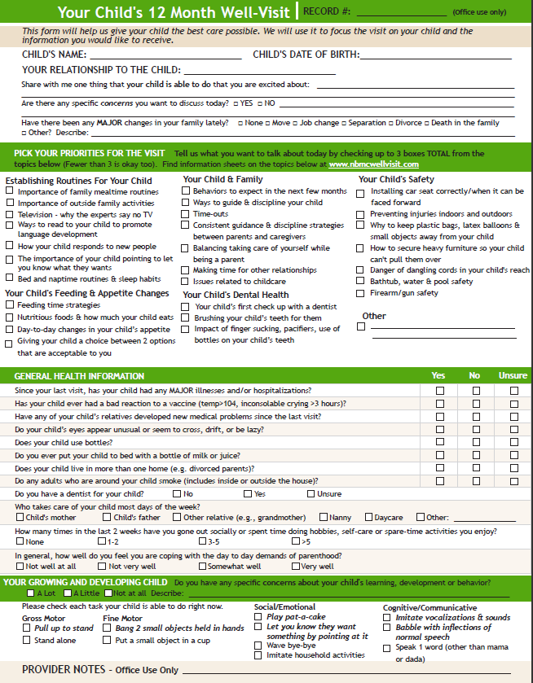
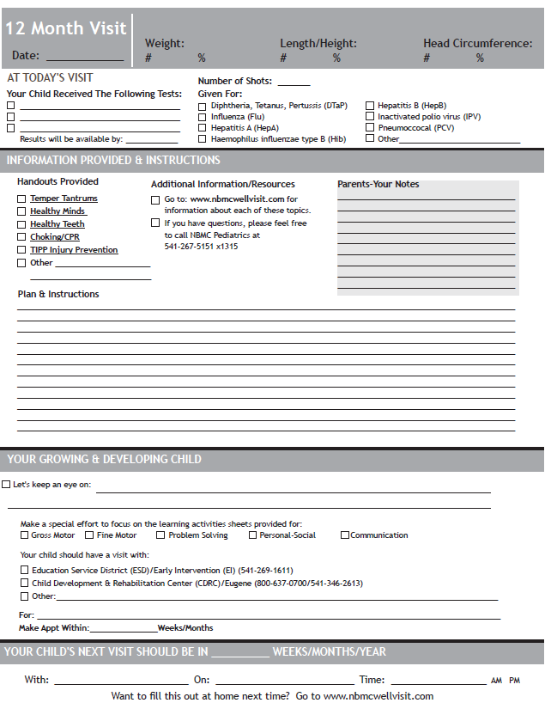
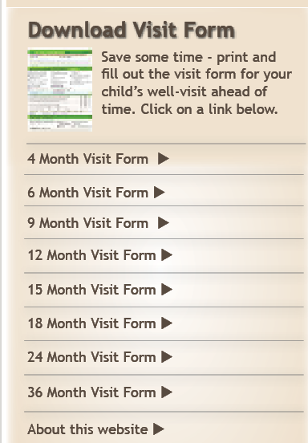
Additional Tools
  Shared Encounter Forms; Educational Website

Slide 19
The Fit with Quality Improvement
Mapping the “cycle of engagement” to the PDSA Cycle
PLAN:
Cycle 1) Baseline PHDS Planning
Cycle 2) Follow-up PHDS Planning
ACT:
Cycle 1) Implementation BF-Related QI Activity: WVP, SEF, Other Activity
  Cycle 2) Refine Implementation
  Invite parent’s to complete the WVP for children ages to 0-3
  Implement processes for providers & staff to review the Visit Guide as a part of the well child visit
  Learn about the PHDS
  Conduct Team meetings to determine how PHDS will be used
  Create PHDS account
STUDY:
Cycle 1) Review Baseline Feedback Reports
Cycle 2) Review Follow-up Feedback Reports
DO:
Cycle 1) PHDS Baseline Data Collection
Cycle 2) PHDS Follow-up Data Collection
  Review provider & practice global feedback reports:
  Anticipatory guidance
  Developmental Surveillance
  Standardized Screening
  Follow-up for children at risk
  Assessment of the family
  Medical Home
  Invite parents to participate using customized parent engagement materials
  (Visit-based)

Slide 20
Patient Engagement Process
1
Communicate with your patients about completing the WVP prior to their appointment
2
Parents go to www.WellVisitPlanner.org and engage with with the interactive website, including age-specific questions and educational materials
3
Parents view, save and print their customized Visit Guide to bring to their child’s appointment. They can also email it to the office ahead of time via a secure email connection.
Email, fliers, posters, postcards, phone calls, etc. (Example materials will be available in the implementation toolkit)
4
Enhanced patient encounter: parents come to the visit prepared, doctors/nurses are prepared to use the visit guide to focus on parental priorities and concerns. Less time needed to ask developmental questions so more time to address developmental concerns and family psychosocial issues

Slide 21

Demonstration of the Well Visit Planner
Engage
Educate
Improve
http://youtu.be/eG-fFjfyqnY

Slide 22
Development & Feasibility (1)
Research:
  Developed and tested over 4 years by the CAHMI for use in pediatric practices to assess: (1) Feasibility; (2) Acceptability; (3) Implementation requirements; (4) Impact on quality of the well-child visit
  Drew on prior knowledge of using the online Promoting Healthy Development Survey to assess quality of well child care in practices
  Funded through an R40 grant from the federal Maternal and Child Health Bureau with additional MCHB support to complete the public use website for dissemination
Content:
  Anchored to the American Academy of Pediatrics’ Bright Futures Guidelines for Health Supervision of Infants, Children and Adolescents, 3rd edition
Expert and Parent Engagement Process
  National experts, families and pediatric providers collaborated in the design, content specification, all aspects of development, implementation and testing of the WVP tools
  Goals: ensure feasibility, optimize impact on the quality and efficiency of the well child visit for parents, children and provider teams

Slide 23
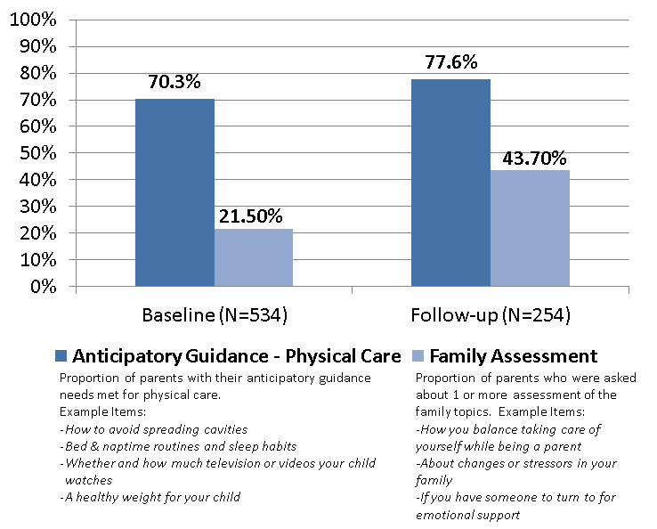
Development, Feasibility, Results (2)
Initial testing documented improvements to provider office work flow, patient engagement and experience and quality of care
  Over 92% of the 3200 parents included in the initial testing reported:
    They would recommend the tool to other parents
    They were comfortable with time required to complete the tool
    Tool helped them understand goals for each well visit and prioritize topics for discussion with their child’s health care providers
The WVP was recognized in the Health 2.0/Academy Health 2012 Relevant Evidence to Advance Care and Health competition
Quality of Care Evaluation Findings
“It not only gets the specific content on the table but it changes the parental expectation… It says this is the kind of stuff that’s under the umbrella of a well-visit. It’s not just that sack of problems visit.”
–Pediatrician
Note. Results are statistically significant at the alpha = .05 level, based on Pearson’s χ2 test for a statistical difference between groups at baseline and follow-up (2-sided).

Slide 24
Slides in Case Demonstration video does not work
Engage
Educate
Improve
http://youtu.be/eG-fFjfyqnY

Slide 25
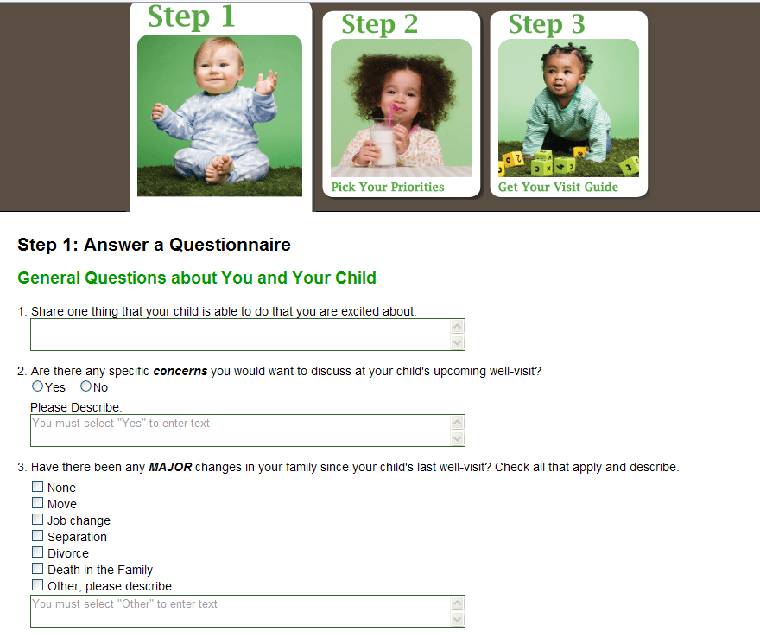
Flow and Content
A strengths and observations based approach as well as addressing any issues parents want to discuss right at the start of the tool
Important family changes and health information

Slide 26
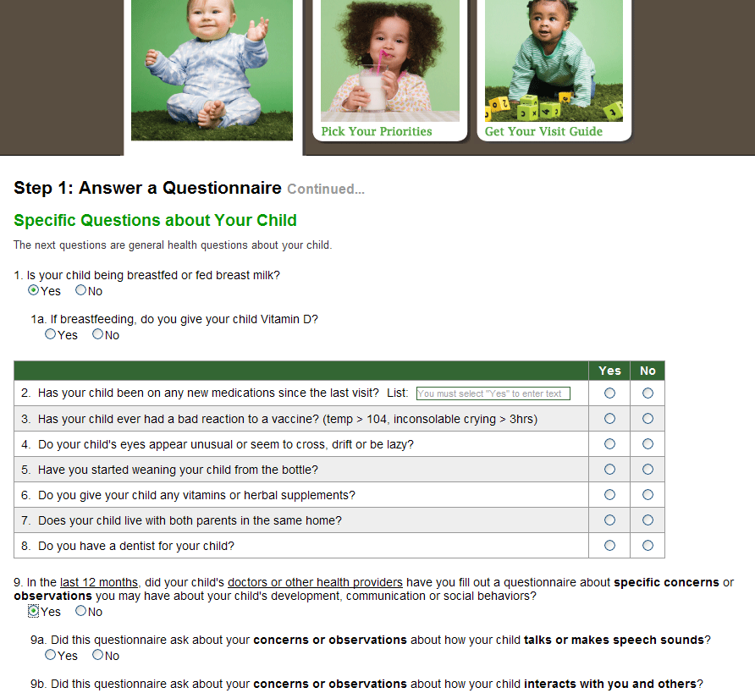
Step 1: Child and Family Information
Child health and functioning (e.g. feeding, immunizations etc.)
Assessment of a prior developmental screening questionnaire being filled out by parent

Slide 27
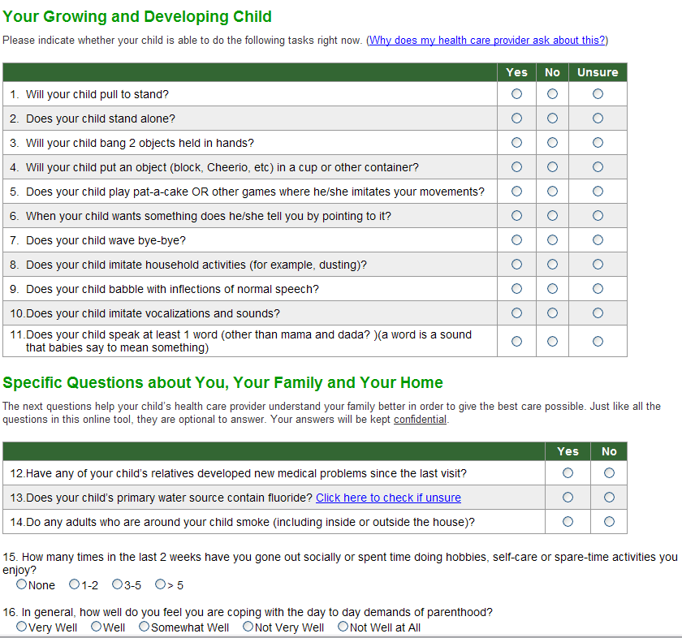
Age-specific developmental surveillance
Important family psychosocial assessment items

Slide 28
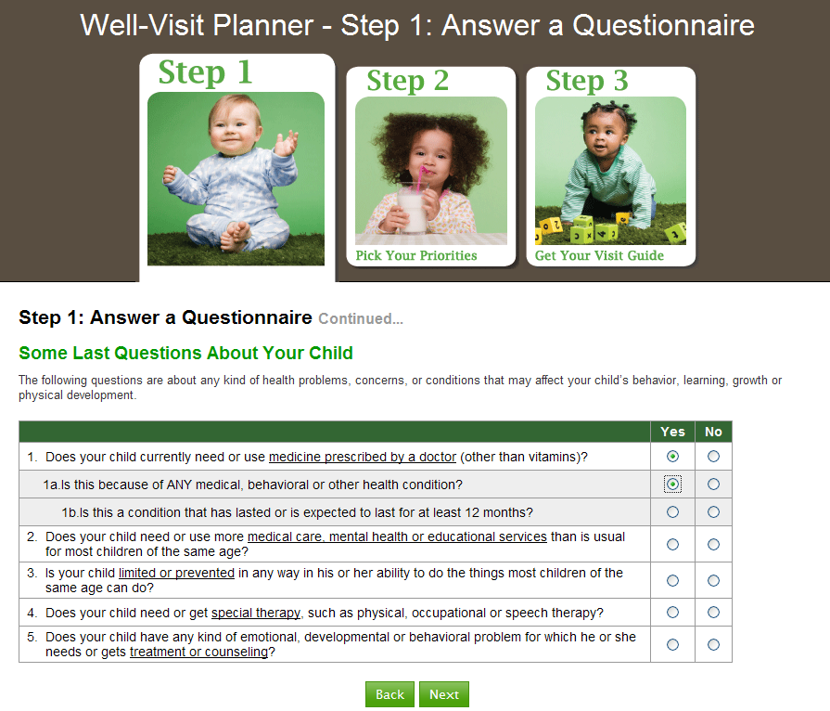
Identification of children with special health care needs

Slide 29
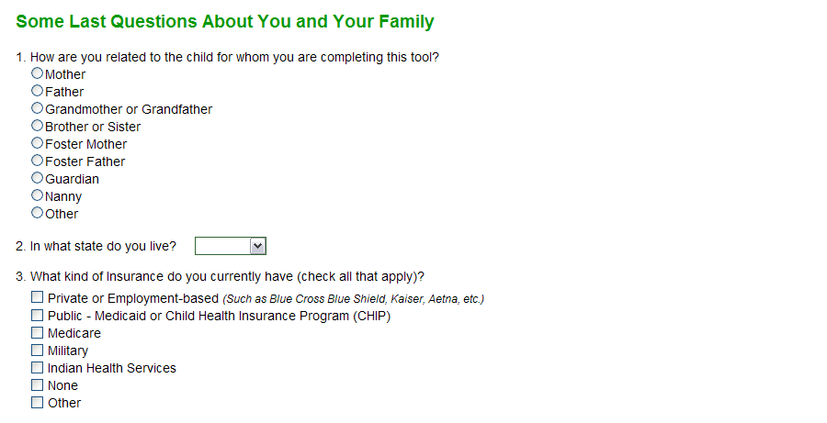
Flow and Content
Basic demographic items
Engaging Parents as Improvement Partners, April, 2013 |

Slide 30
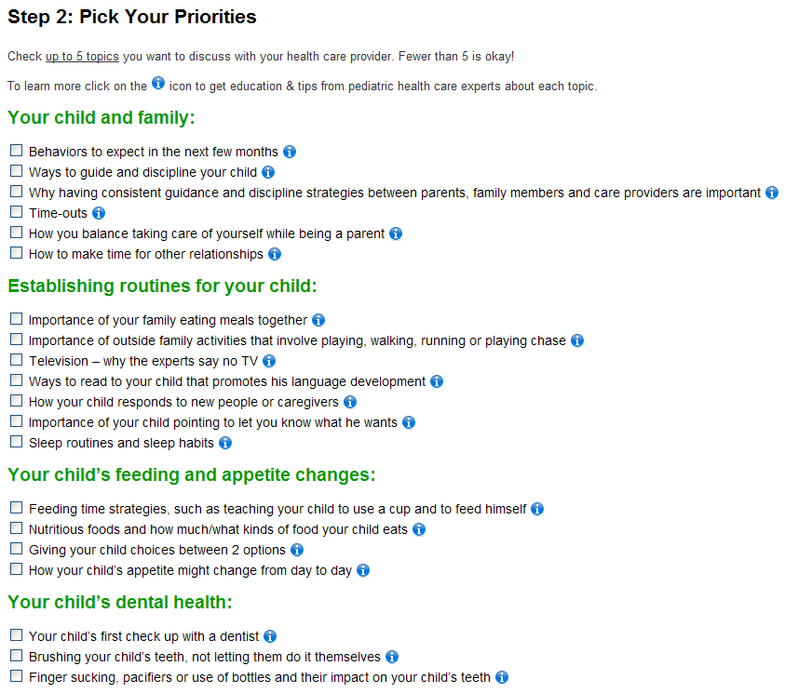
Step 2: Pick Your Priorities

Slide 31
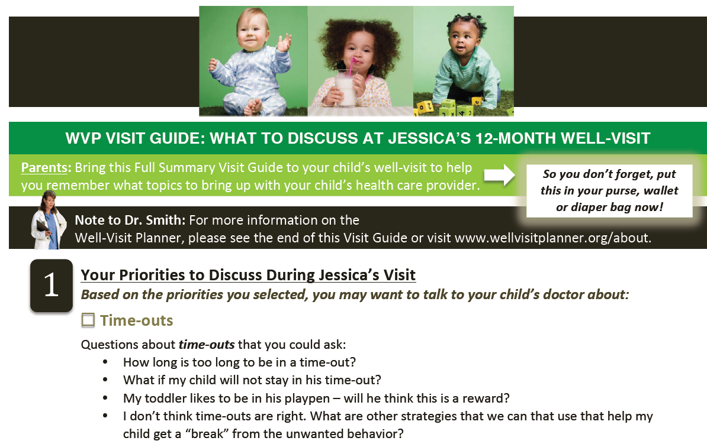
Step 3: The Visit Guide
After completing the tool, a customized visit guide is generated for use by both parents and their child’s health care provider(s). The entire online time for most parents is roughly 10 minutes

Slide 32
IMPLEMENTING the
Well Visit Planner Tools
Engage
Educate
Improve

Slide 33
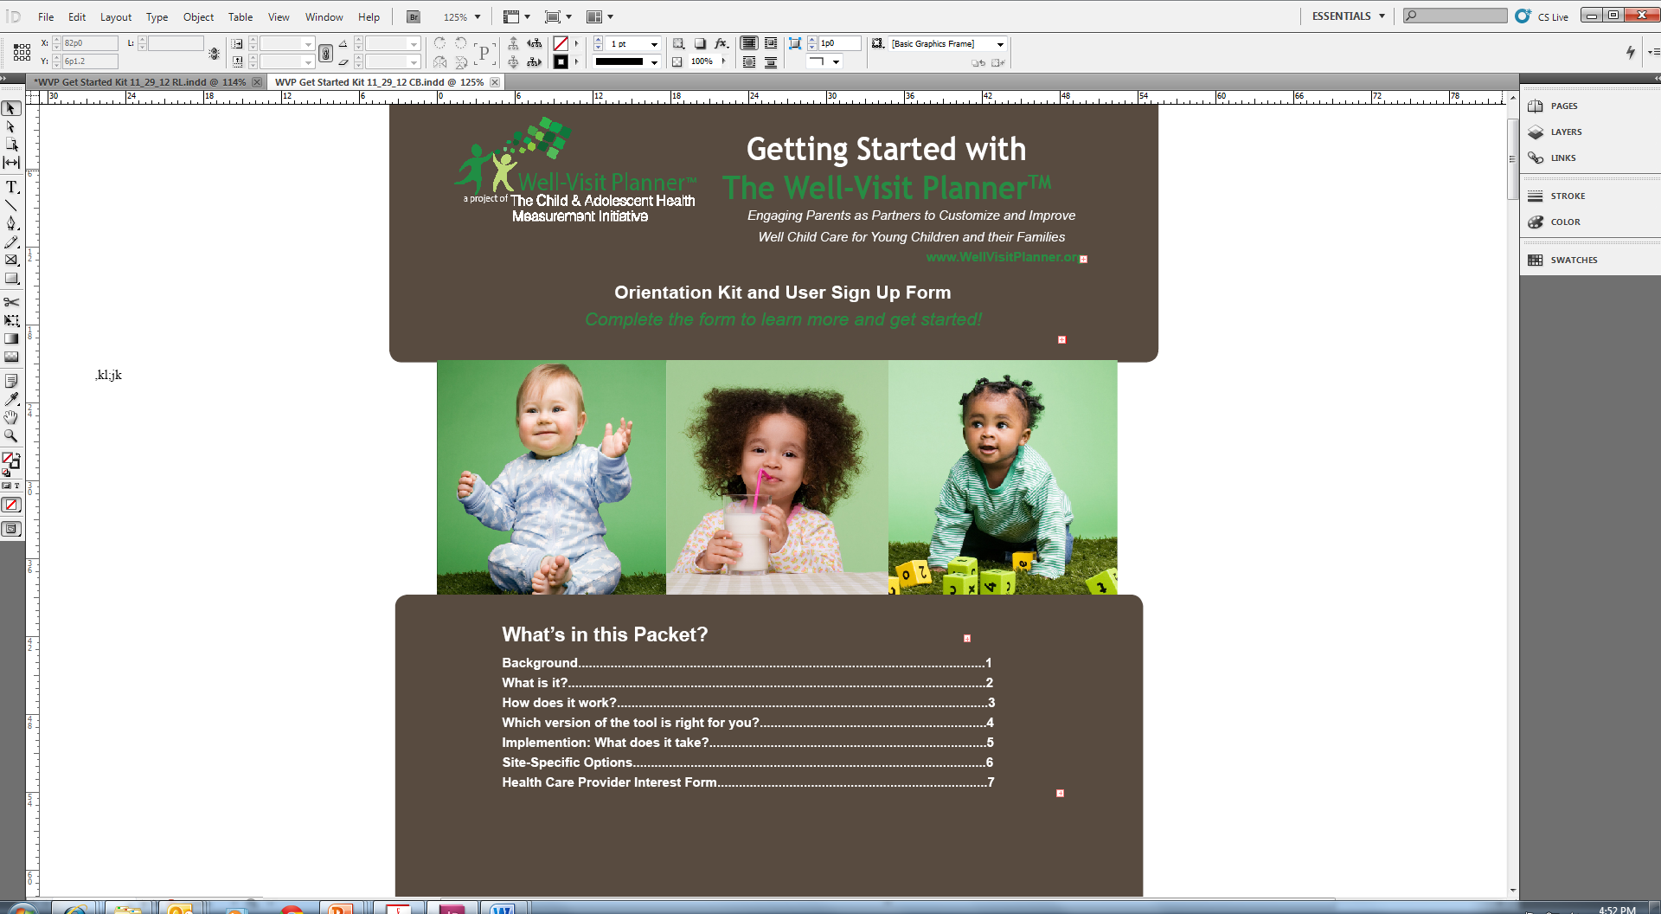
Get Started with the Orientation Kit and Users Sign Up Form
Improve

Slide 34
Selecting the Right tool(s)
Engage
Educate
Improve

Slide 35
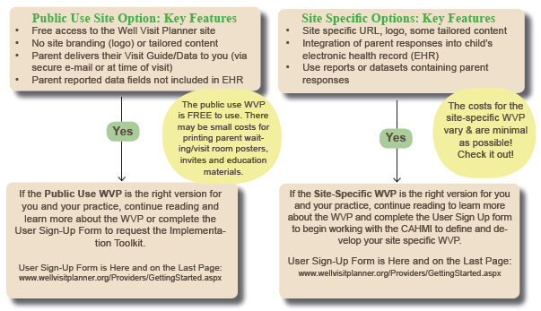
Two Primary Options
1) Free public use website…start now! 2) Site-specific

Slide 36
Detailed Options
Public Use Website (free) as seen on www.wellvisitplanner.org
Receive the Public Use Implementation Toolkit and start using the WVP today
Supplement the Public Use WVP with the abbreviated paper-pencil version, Shared Encounter Forms (a good back up option for parents that forget to complete the WVP online)
Spanish language version of the Public Use WVP (currently under development, projected completion summer 2013)
Basic Site-Specific Options
Unique URL (e.g. myclinic.wellvisitplanner.org)
Branding (e.g. your clinic’s logo/contact information)
Summary reports or full datasets on your patient population
Add links to external developmental screening tools (for which you have license)
Tailoring some of the questions asked in the tool (allowable customizations are limited)
Enhanced Site-Specific Options (involves close partnership due to PHI and advanced technical development)
Receive parent Visit Guides and responses in PDF format via secure email or fax (vs. parent delivery only)
Integrate parent response directly into fields in your electronic health record (EHR)
Other Supplementary Options
Measure and improve quality by pairing the WVP with the Promoting Healthy Development Survey (PHDS), an online parent-completed tool that yields automated quality reports with 8 nationally endorsed quality indicators from aggregated parent responses
Use the WVP to help meet Meaningful Use requirements (still under development)
Use the WVP for Maintenance of Certification (still under development)

Slide 37
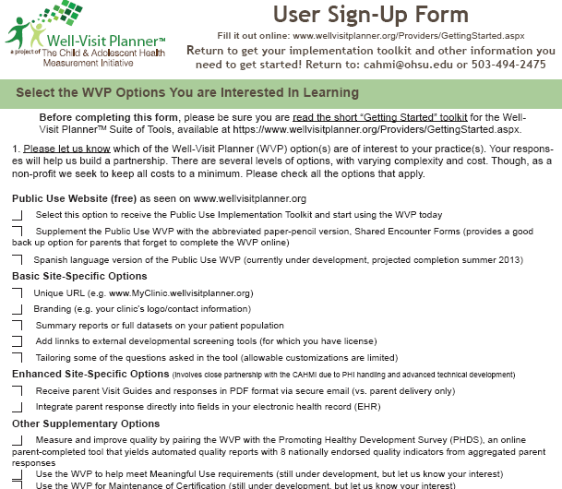
User Sign-Up Form
Available at wellvisitplanner.org/ Providers/Default.aspx

Slide 38

Practice-Based Implementation Toolkit
Overview of the tool
Engaging the practice team
  Example Focus Groups, staff and provider surveys, meeting agendas and presentation materials
  Time Tables and Check Lists
  Office Flow Diagrams and Analysis
  Handling the cultural shift represented by patient engagement; sample scripts to invite and engage parents
Resources
  Flyers, Post Cards and Communication Materials
  Presentations, videos, etc.

Slide 39
Requirements for each WVP implementation option
 | Implementation Options
Requirements | Public Use Site WVP | Unique Clinic URL for WVP | Site-specific URL, Branding | Site specific URL with customized content | EHR Integration of Visit Guides (PDF) | Full EHR Integration Module
Engage Staff (Develop culture of engagement, momentum and office champions) | X | X | X | X | X | X
Engage patients (Develop posters and engagement materials) | X | X | X | X | X | X
Office Flow (Work to include engagement into flow of well-child visits) | X | X | X | X | X | X
Develop EHR system for inclusion of PDF |  |  |  |  | X
Develop EHR system for manual import of HL7 file |  |  |  |  |  | X
Develop EHR forms for full automated integration of data into visit |  |  |  |  |  | X

Slide 40
Office Flow
Clinic Scheduler
* Children with upcoming well-child care visits who are eligible for parents to participate in Well Visit planner are identified
* Five days before well-child visit, parent is reminded about visit and told to go to website. This can be done along with a practice’s existing process, i.e. telephone and/or email appointment reminder.
Parent
*Some (not all) parents complete tool AT HOME
*Parent prints Visit Guide at home
*Parent can visit WVP educational material website anytime
Front Desk Check In
* Aware of the project and able to answer questions
MA/RN
* Asks eligible/invited parents if they filled out the WVP
* Ask parent for Visit Guide to make a photocopy for health care provider to use during visit and for the patient’s record
* Review Visit Guide and follow up on any items appropriate for MA/RN to discuss with parent, make entries/notes in chart or electronic health record
During Visit
Provider
* Review Visit Guide and MA/RN notes, if applicable
* Address parent’s concerns, priorities and health screening flags
* Guide parent to parent education materials on website
After Visit
Parent
* Can go back to website for the educational materials and resources
Before Visit

Slide 41

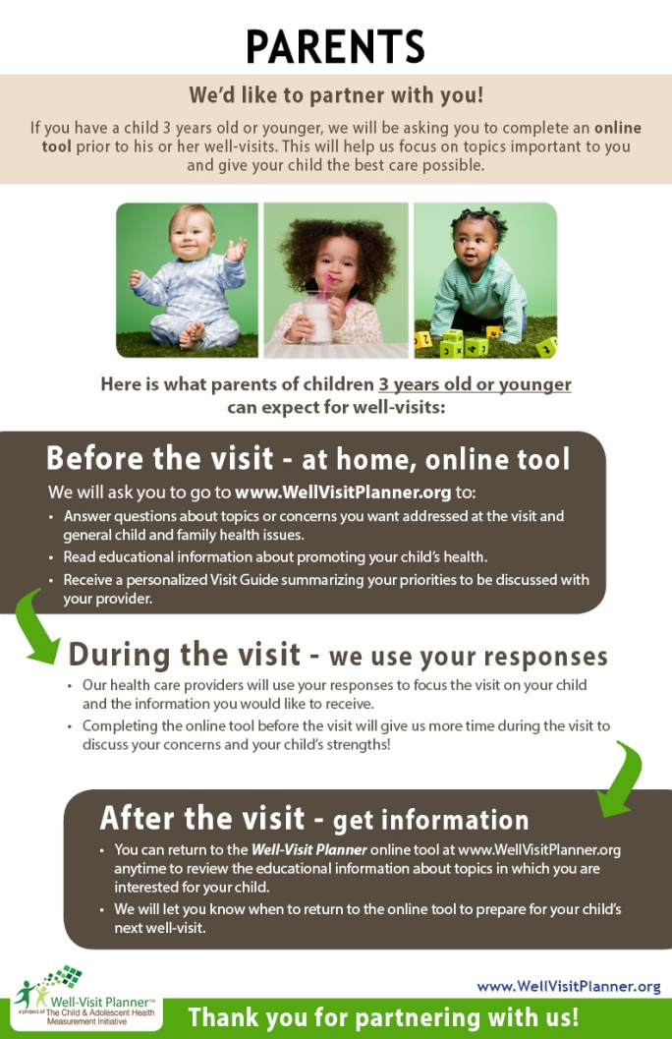
The Cultural Shift
  Families may not be accustomed to being engaged, particularly prior to a visit
  A friendly office environment with posters about the desire and need for families to engage— “We need your participation!”
  Encouragement that doing the WVP ahead of time is best for the provider and the family, and the child will benefit

Slide 42
Putting it All Together: An Online Package for pediatrician Maintenance of Certification
Registration & Customization Portal
Quality Measurement Toolkit
OnlinePHDS
Parent Engagement & Education Toolkit
WVP
User: Provider/Practice
- Provider Information
- Selection of Tools (PHDS, WVP, SEF, Education)
- Customization of Tools (e.g. components of tools, reporting preferences)
User: Provider/Practice
- Summary of customization preferences
- Implementation guidance (including parent engagement materials)
- Reporting Management
- Background Information
User: Provider/Practice
- Suite of Parent Websites
- Provider/Practice-Specific URL
SEF
Education Website

Slide 43
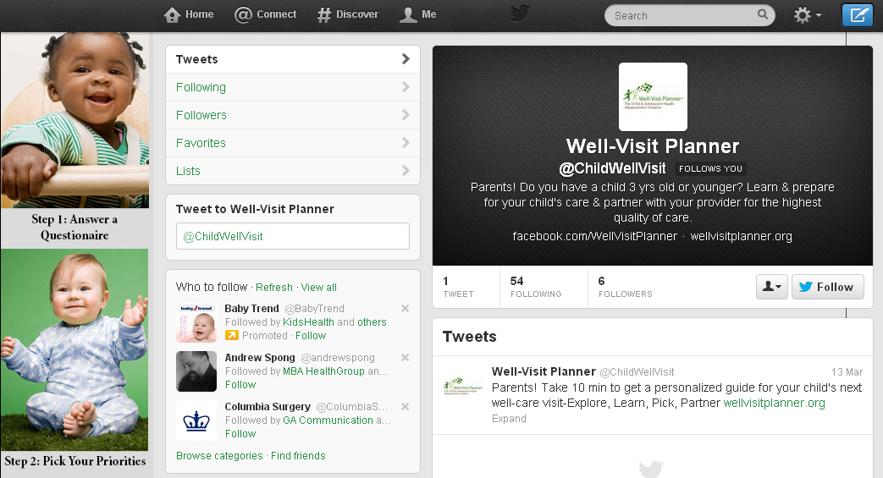
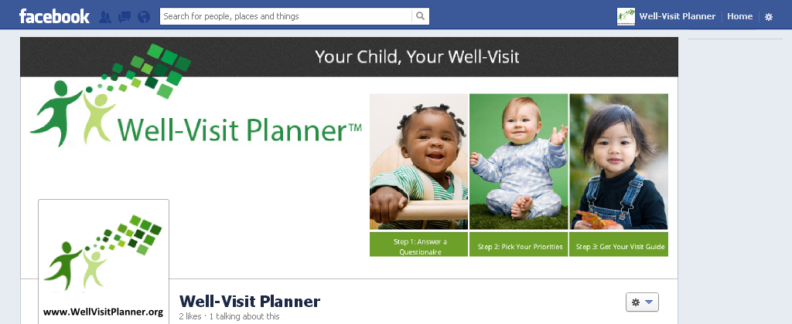
Working Directly with Parents
Building key partnerships
  Family Voices, AAP, Text4Baby, March of Dimes, etc.
Social Media and Pubic Information for Parents
“As a busy mom it’s hard to find time to do things… having a smart phone app to be able to do it.. They [the parent] could do [the WVP] at their kid’s soccer game.”
– Focus Group Participant
“Patients are going to love [the WVP]. The new families that are part of this generation.”—Practice Staff Member

Slide 44
Future Developments
New topic/content modules & versions
  Fill out for other ages
  Adolescent version
  Children with Special Health Care Needs (CSHCN)
  Continue to scale
  Expand capacity to work with many practice sites
  Continue to evaluate and renew content
  Continue building research partnership to ensure on-going assessment and improvement of tools
  Field development
Ongoing research and evaluation!!!

Slide 45
The Translation Transition
  Disseminating and supporting web-based tools require the capacity to:
    educate and support tailored implementation and
    maintain, routinely update and improve to tools
    support alternative implementation models (e.g. practices; early head start; ACO/CCOs, Family Voices)
    develop new collaborations to ensure consistency and optimize value
    address cultural shift entailed
    specify and implement allowable customizations
    address inevitable needs for tailored content modules
  Integration of patient data into the EMR is logistically feasible, but scaling such technologies involves specifying and addressing many legal, logistical and technical requirements of alternative EMR systems

Slide 46
Why Early Childhood and Why Now?
Critical Developmental Period
~12 Well-Child Visits in first 3 years
Health Care Reform and Transformation
ACA and CHIPRA
Meet Goals with Greater Ease and Efficiency
The easy to use Well Visit Planner tools help providers efficiently measure and engage parents in improving care
Gaps Persist Though Guidelines Exist
<10% of young children meet minimum criteria for receiving quality care
Key for preventive/ developmental care delivery
Long-term impact: demonstrated implications for health, well-being, school and life success
Sig. variation in quality of care by child and family characteristics, provider, office, health system
Variation exists both within and across providers
Tailored Communication & Partnering w/ Patients is Essential
Improving care means :
improving communication and partnerships with parents and
meeting the unique priorities and needs of each child and family
PC Outcomes Research Institute
US Secretary of Health’s National Quality Strategy
PC Medical Home initiative
Institute of Medicine “Best Care at Low Costs”
The Joint Commission’s High Reliability Organizations model
Maintenance of Certification
Meaningful Use
No-one is achieving high-quality all of the time

Slide 47
Thank You to Our Many Partners
Thank you to all of the staff, advisors and family involvement in the development of the WVP website
The staff at the Child and Adolescent Health Measurement Initiative
The entire staff at The Children’s Clinic in Tigard, Oregon
The federal Maternal and Child Health Bureau
UCLA and FQHC partners
Boston Children’s Hospital/PPCO
The Children’s Health Alliance
OHSU General Pediatrics
National Advisory Committee
Betsy Anderson Cynthia Minkovitz
Jane Basowitz Amy Perretti
David Bergman Edward L. Schor
Greg Blashke Judy Shaw
Dimitri A. Christakis Sara Slovin
John Kilty
Paula Duncan
Parent Advisors
Tami Olson
Emily Brophy
Kellena Collier
Amy Kurian
The WVP was developed and tested by the Child and Adolescent Health Measurement Initiative (CAHMI) for use in pediatric practices over four years and through a grant from the federal Maternal and Child Health Bureau (R40 MC08959). Its continued development and implementation is supported by the CAHMI, volunteer advisors and through support from HRSA/MCHB through Cooperative Agreement U59-MC06890.

Slide 48
Thank You!
Getting materials: Slides, video and other informational materials are posted at wellvisitplanner.org
  Contact Information:
  Christina Bethell
  Phone: 503-494-1892
  Email: bethellc@ohsu.edu
  Fax: 503-494-2475
  The CAHMI
  Phone: 503-494-1930
  Email: CAHMI@ohsu.edu
  Website: www.cahmi.org

Slide 49
Questions?
Engage
Educate
Improve

Slide 50
Extra Slides

Slide 51
Summary
Family-centered quality improvement
Parents learn about and identify priorities and key issues prior to visits
Access to educational materials and discussion tips
Enable customization and optimal use of visit time
Available for the 4, 6, 9, 12, 15, 18, 24 and 36 month well -visits
Bright Futures defined visit-specific focus areas
Measure, Track, and Evaluate Quality Improvement
Cycle of
Partnership
Engagement
Activation
Measurement
Improvement

Slide 52
Additional Information on Implementation
Engage
Educate
Improve

Slide 53
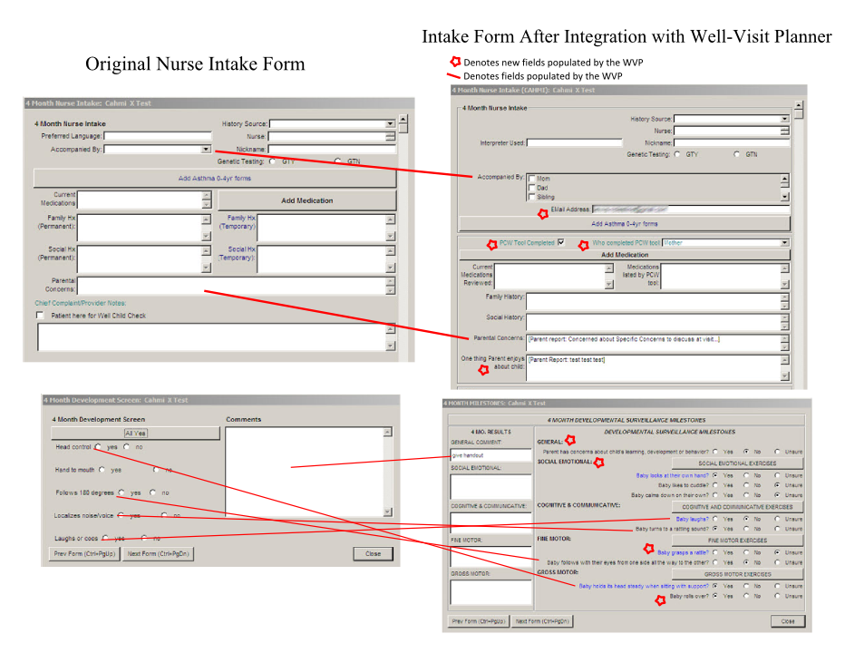
Secure EHR Integration & Data Transfer
Full Integration (PHI)
E-mail/Fax (without PHI)

Slide 54
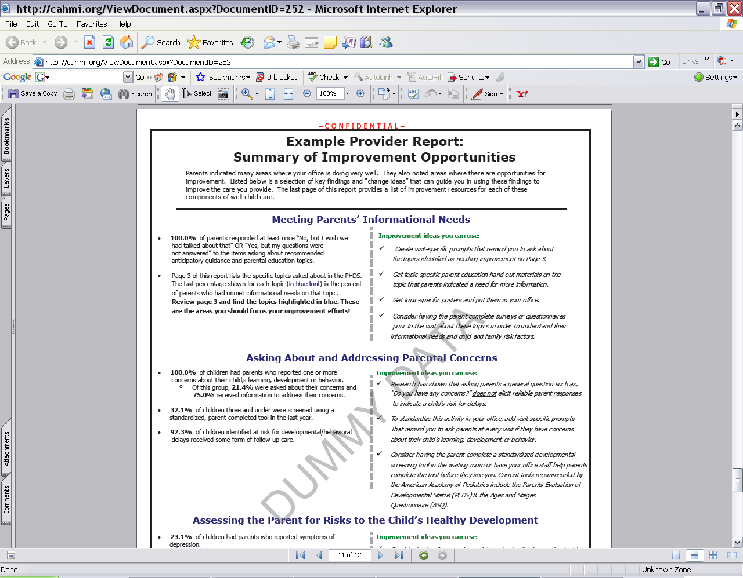
Aggregated Data Reports and Full Data Sets

